Slide 1

Titanic
Krishna Sai Desaboina

Slide 2
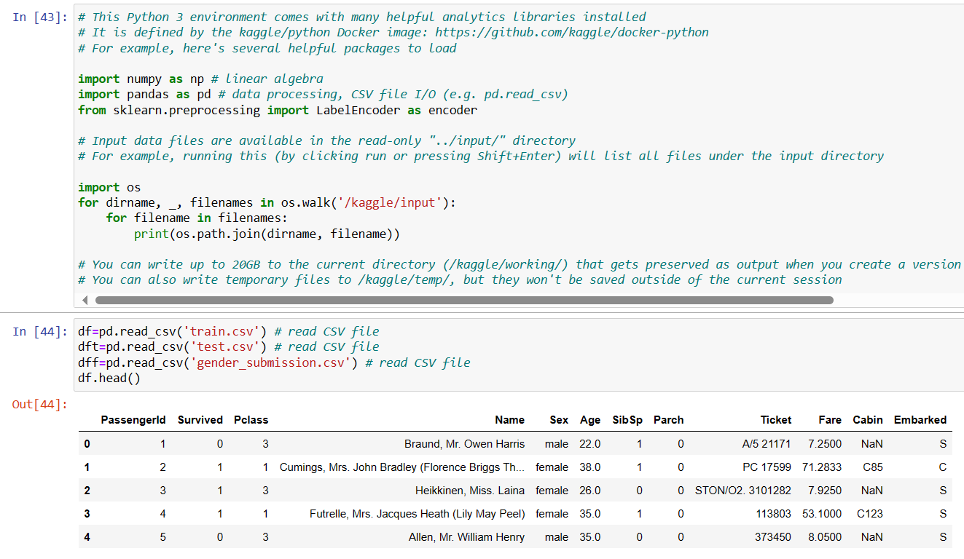
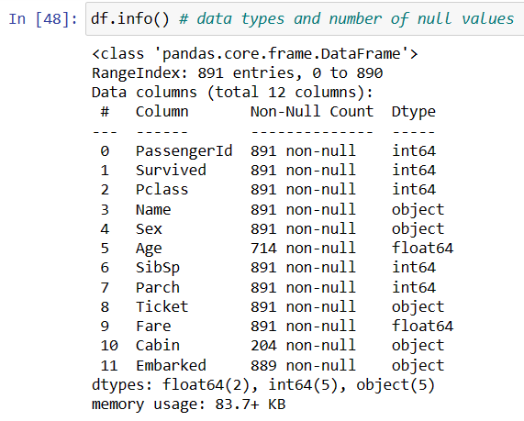

Slide 3
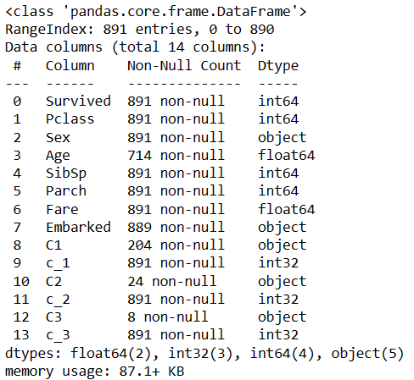

Divided Composite value Cabin to Simple Values:

Slide 4
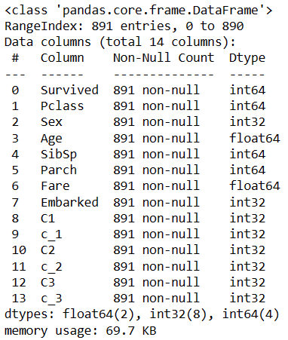
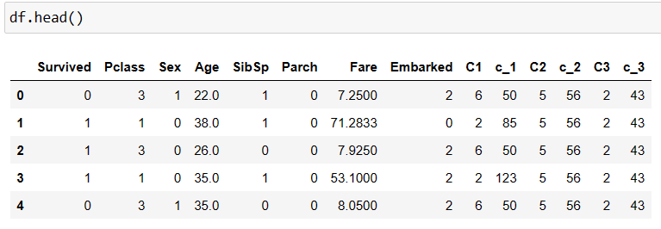
After Converting Categorical values to Numerical and Eliminating NaN values:

Slide 5



Out of 500 only 120 Survived of 3rd class.

Slide 6
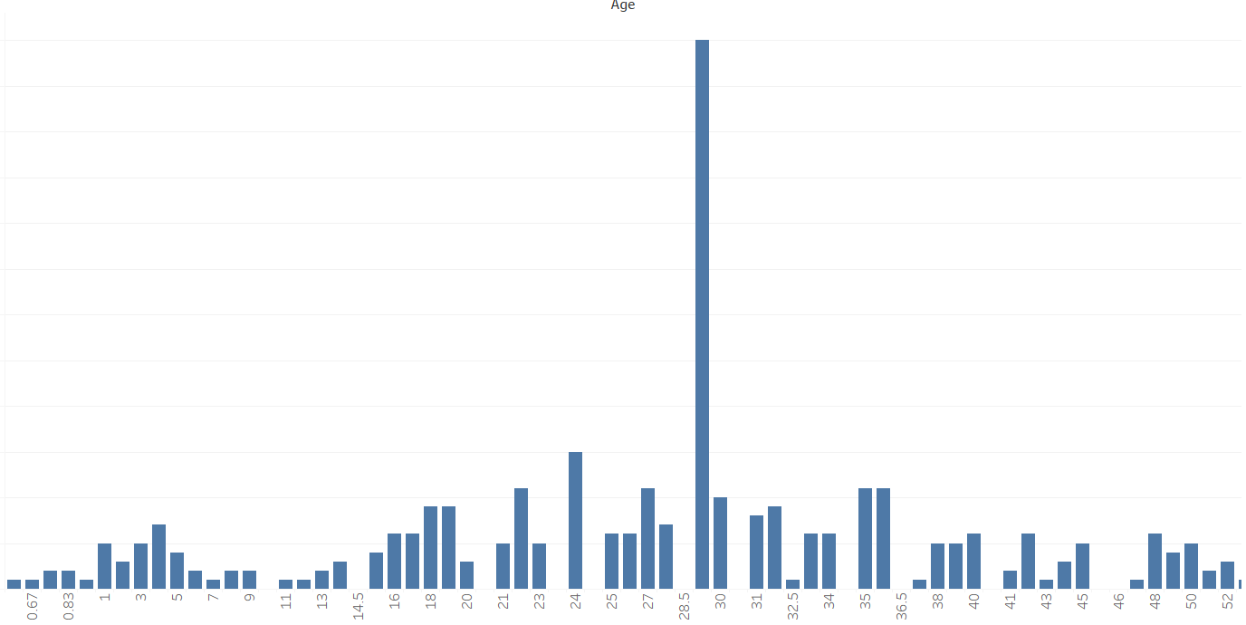
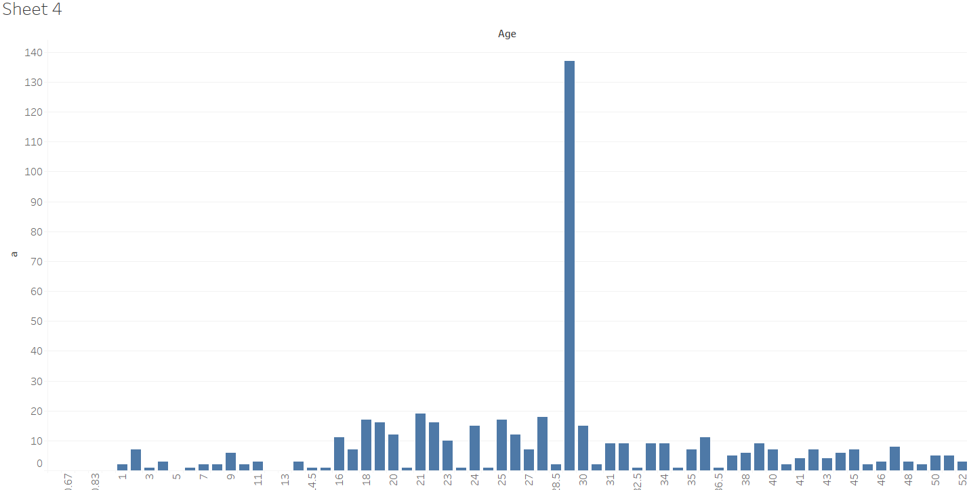
Out of 197 only 60 Survived of age 29

Slide 7





Slide 8
Conclusion:
There are more deaths compared to survivors.
Most of the first-class people survived and most of third class people died.
If you are a female, Whatever class you take your chances of survival is more.

